Slide 1
D3.js Figures
Upwork .

Slide 2
Pharmacokinetic : Spaghetti plot
- one line for each subject (SUBJID),If possible different color for each line.
-Concentration (AVAL) in vertical axis, with the label (PARAM)
-Time (EPLTM or PCTPT), and label : Time (Hours)
- Possibilty to choose what we display :
- By period (APERIODC). Defaut is Period 1. We display only one period.
- By Analyte : PARCAT1. First coming analyte by Default (alphabetic order ? ) .We display only one analyte.
- By sex (SEX) , by age (AGE) , by race (RACE). Here can have also the possibility to choose All. Default is All.
When we have the mouse over a line , we display : Subject number (SUBJID), Treatment sequence (TRTSEQA).
When we click on a line we display a table containing all data related to that subject.

Slide 3
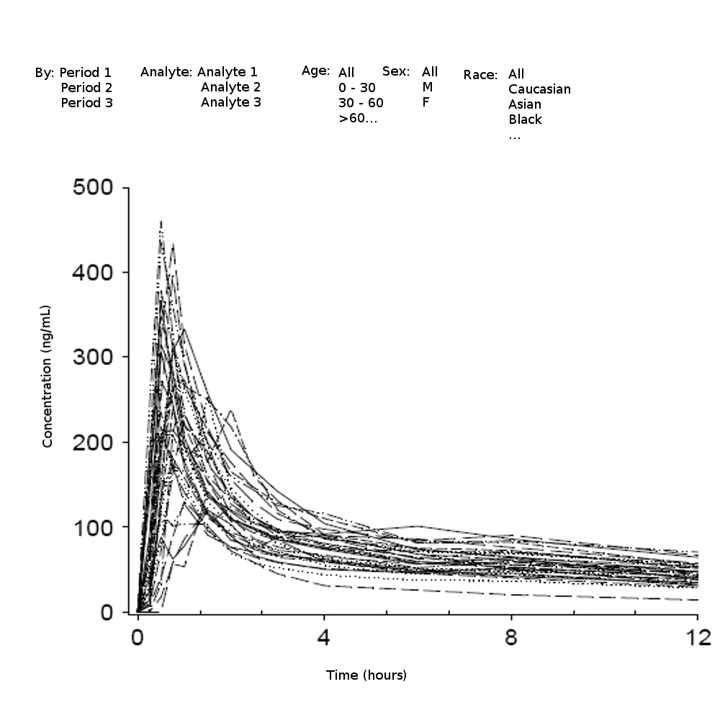
Pharmacokinetic : Spaghetti plot

